Slide 1
Project Kick-off sErvitization of Industry X.0 Assets powered by secure, Resilient and immersive digital twin teCHnologies
National and Kapodistrian University of Athens
November 21, 2025

Slide 2
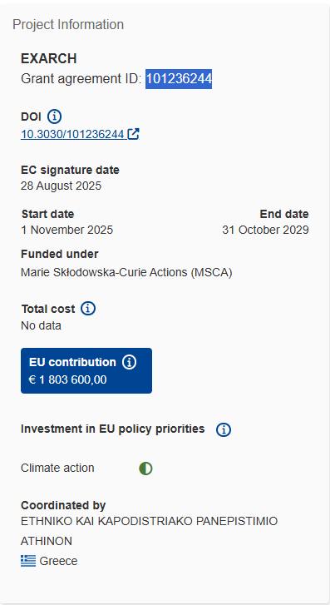
sErvitization of Industry X.0 Assets powered by secure, Resilient and immersive digital twin teCHnologies
Objectives in a few words
  Design, implement, and experimentally demonstrate the performance of a modularized Digital Twin platform, along with algorithmic innovations, to support of the emerging Asset-as-a-Service paradigm.
  EXARCH brings forth cloud-native microservices that fully leverage exciting new capabilities by 6G with semantics-aware 3D reconstruction to create an immersive user-centric service suite, designed to automate AaaS management, addressing unique cybersecurity challenges posed by AaaS while making the most out of the digitalization of IX.0 assets.
Call
  HORIZON-MSCA-2024-SE-01-01 - MSCA Staff Exchanges 2024

Slide 3
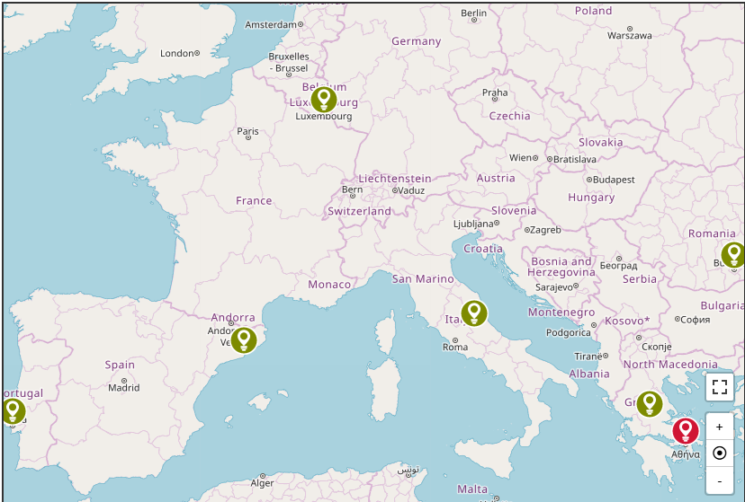

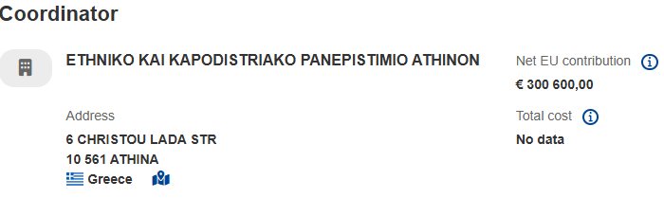
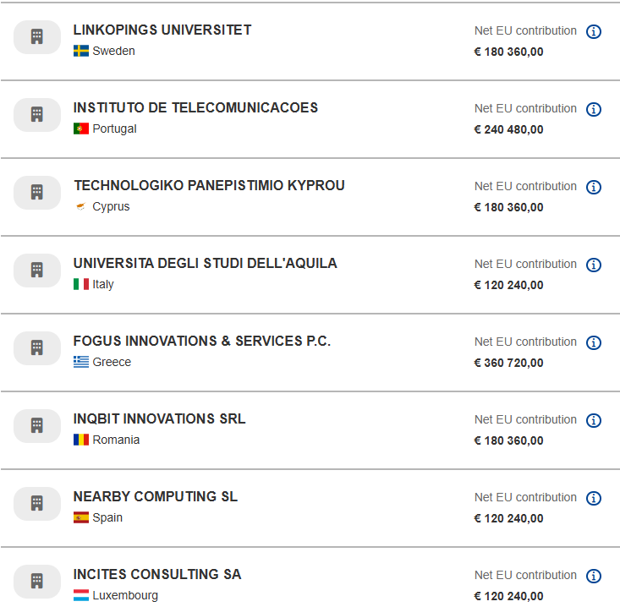
Consortium

Slide 4


DO NOT TOUCH THIS IS THE LOGO
E RCH

Slide 5
Num | Rel. No in WP | Name | Lead | Type | Diss Level | Due Date
D1 | D1.1 | OEI - Requirement No. 1 | UOA | ETHICS | SEN | 4
D2 | D2.1 | EXARCH AaaS system architecture, scenarios and technical specs | INC | R | PU | 24
D3 | D3.1 | Digital Twin technologies and platform for Industry X.0 | UAQ | R | SEN | 30
D4 | D3.2 | Performance evaluation and implementation of the EXARCH Digital Twin | FOG | R | PU | 42
D5 | D4.1 | SotA review on distributed, intelligent and DT-backed security protocols | CUT | R | PU | 12
D6 | D4.2 | Design and performance evaluation of the EXARCH cybersecurity framework | IQB | R | PU | 42
D7 | D5.1 | EXARCH AaaS management framework design, evaluation and testing | INC | R | PU | 42
D8 | D6.1 | EXARCH PoC Platform Integration, Testing and Documentation | UOA | R | PU | 47
D9 | D8.1 | Data Management Plan (DMP) | NBC | R | PU | 6
D10 | D8.2 | Data Management Report | NBC | R | PU | 48
D11 | D8.3 | Mid-term meeting | UOA | R | SEN | 16
D12 | D7.1 | Dissemination, communication, standardization, public engagement plan | IT | R | PU | 6
D13 | D7.2 | Dissemination, communication, standardization, public engagement (Intermediate) | UAQ | R | PU | 24
D14 | D7.3 | Dissemination, communication, standardization, public engagement report (FINAL) | UAQ | R | PU | 48
D15 | D8.4 | Progress Report | UOA | R | SEN | 13

